Slide 1




CSC3031Research and Project skills: Video & Oral Presentation
By Ian Givero

Slide 2
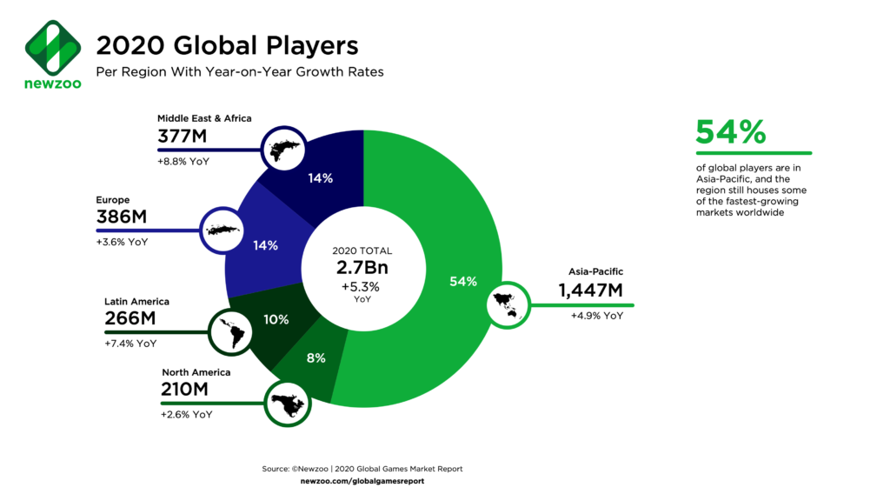
Accessibility in Games: Integrating video game accessibility features to lower barriers to access faced by people with disabilities.

Slide 3
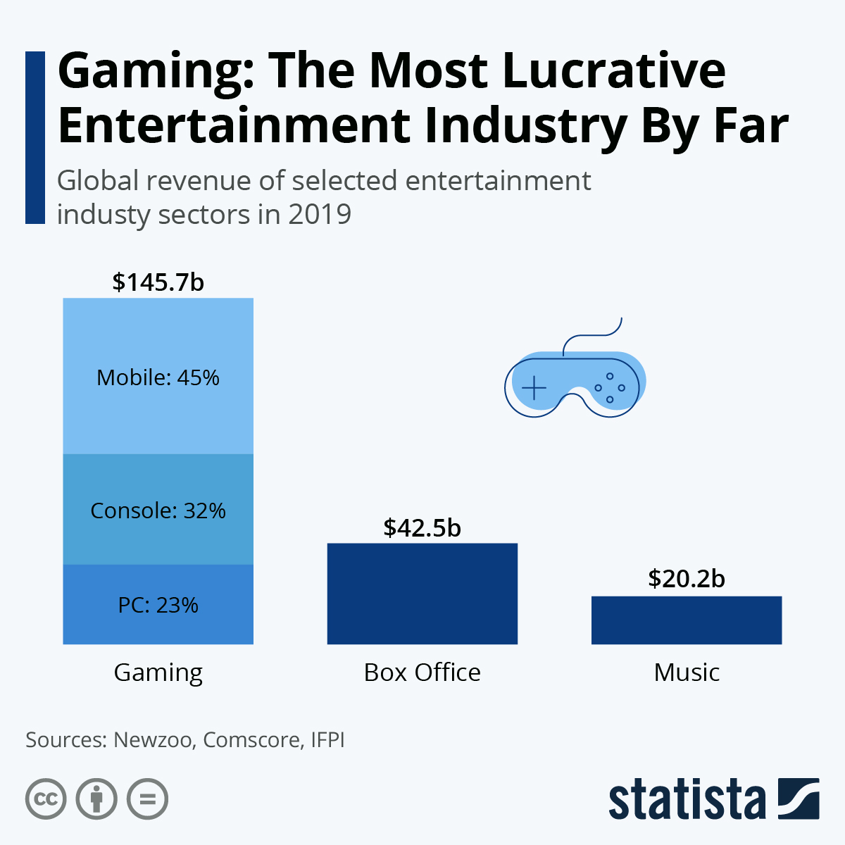
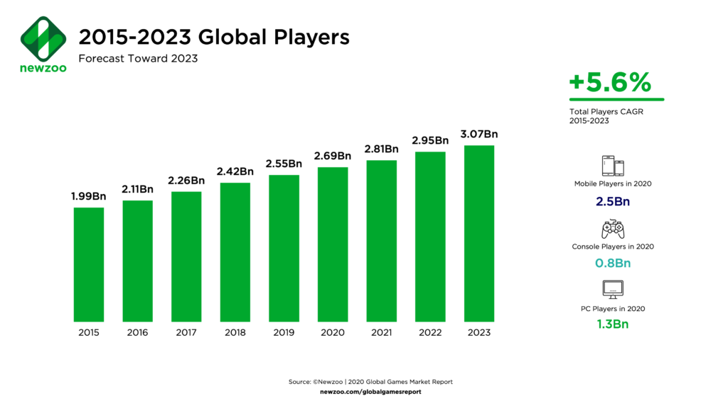
Overview of the gaming industry
Size of gaming industry
Gaming population
Gaming is the biggest entertainment industry by revenue.
Bigger than the movie and music industry combined!
Over 2 billion gamers across the world. That is 26% of the world’s population [1].
Over ¼ of the world’s population are gamers!
Gaming population is expected to continue growing.
Expected to rise over 3 billion by 2023

Slide 4
Gamers facing barriers to accessibility
A billion people experience some form of disability, 15% of global population [2]
Survey of 13,296 casual gamers, around 20.5% (2,728) identify themselves as having some form of disability [3]
Statistically speaking, disabled gamers tend to spend more time gaming per week than casual gamers overall

Slide 5
Understanding why disabled players continue to play games despite the challenges
Among surveyed players, 94% of disabled players continue to play [4]
WHY?
Deeper sensations of achievement and belonging
Distraction from loneliness or chronic pain
A form of escape or refuge

Slide 6

Motivation & rationale
Why put emphasis on Accessibility for Games?
Gaming is the biggest entertainment industry in terms of revenue.
Second largest media industry, just behind TV industry (mainly due to advertising)
20% of Gamers are disabled.
Disabled gamers have more engagement compared to most gamers.
Accessibility = Inclusivity = Bigger Target Audience
The numbers make good business sense
Human benefit: Barriers to access will be lowered for disabled people.

Slide 7

Aim: To develop a Unity game which incorporates accessibility features to help facilitate the experience and challenges encountered by players with accessibility issues.
Objectives:
1.) Explore and identify a set of common gaming accessibility barriers and investigate established audio-visual techniques that are used to assist players facing such accessibility barriers.
2.) Develop distinct, individual prototypes focused on each selected accessibility barrier.
3.) Develop a game that integrates all accessibility techniques into the main game loop.
4.) Analyse and evaluate how well the integrated accessibility features satisfy established accessibility guidelines in gaming as well as its impact on the game’s performance.

Slide 8

The chosen approach to tackle the project
Research
Identify common accessibility issues experienced by users
Identify accessibility techniques used in games
Develop Unity Game
Agile development methodology
Adapt a Feature-Driven Development approach – Features to help with Visual Impairment, Motor Impairment, etc.
Evaluate finished product: How well it satisfies Accessibility Guidelines

Slide 9

risks
Hardware/device damage
University Clusters as alternative
Storage compromised
Cloud storage backup
Falling behind schedule/timeline
Use Easter break as buffer period

Slide 10
Current progress and workplan
CSC3031 – Week 1: Initial Research
CSC3031 – Week 2: Develop prototypes for Supervisor approval
CSC3031 – Week 3: Continue developing prototypes
CSC3031 – Week 4: Focus on Video & Oral Presentation
CSC3031 – Week 5: Focus on Ethics Form & Proposal
CSC3032 – Week 6-8: Develop main software artefact
Easter Break – Week 9-12: Easter Break with occasional Dissertation Writing
CSC3032 – Week 13-15: Evaluate Game and Finalise Dissertation

Slide 11
references
[1] A. Beattie, “How the Video Game Industry Is Changing” Investopedia, Oct. 31, 2021. [Online]. Available: https://www.investopedia.com/articles/investing/053115/how-video- game-industry-changing.asp. [Accessed: Feb. 23,2022]
[2] World Health Organisation, “World Report on Disability,” World Health Organisation, 2011. [Online]. Available: https://www.who.int/disabilities/world_report/2011/report.pdf [Accessed: Feb. 23, 2022]
[3], [4] Games Industry International, “PopCap Games research: Publisher's latest survey says that casual games are big with disabled people.” Games Industry, June 11, 2008. [Online]. Available: https://www.gamesindustry.biz/articles/popcap-games-research-publisher-s-latest-survey-says-that-casual-games-are-big-with-disabled-people

